Slide 1
Quality analysis using image processing
Of REAL TIME DATA in Industry 4.0
Advisor:
Dr. Faraz Junejo
Group Members:
Zohair Lokhandwala 1612258
Sibte Abbas 1612135

Slide 2
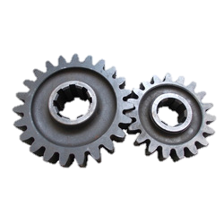
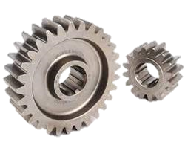
Introduction
All gear manufacturing industries aim to produce various competitive products. The competition enhancement depends mainly on productivity and quality of the Gears produced by each industry. In this sector, there have been an enlarge amount of losses due to defective products. Most defects arising in the production process are still detected by human inspection. Digital image processing techniques have been increasingly applied to gear samples for analyzing the product.

Slide 3
Objective
To design a system that will detect defects and check the overall quality of the automotive gears in industries using Digital Image Processing.

Slide 4
Tools
Python
Application Areas
All Automotive Industries

Slide 5
Main Features
Check for surface roughness in the Gear
Count number of teeth’s in the Gear
Check the size of the Gear

Slide 6
Features Completed till Date
Count number of teeth’s in the Gear
Remaining Features in FYP -1
Calculate Size and Surface Roughness

Slide 7
Canny Edge Detection algorithm
The Process of Canny edge detection algorithm can be broken down to 5 different steps:
Noise Reduction
Gradient Calculation
Non-maximum Suppression
Double threshold
Edge tracking by hysteresis

Slide 8
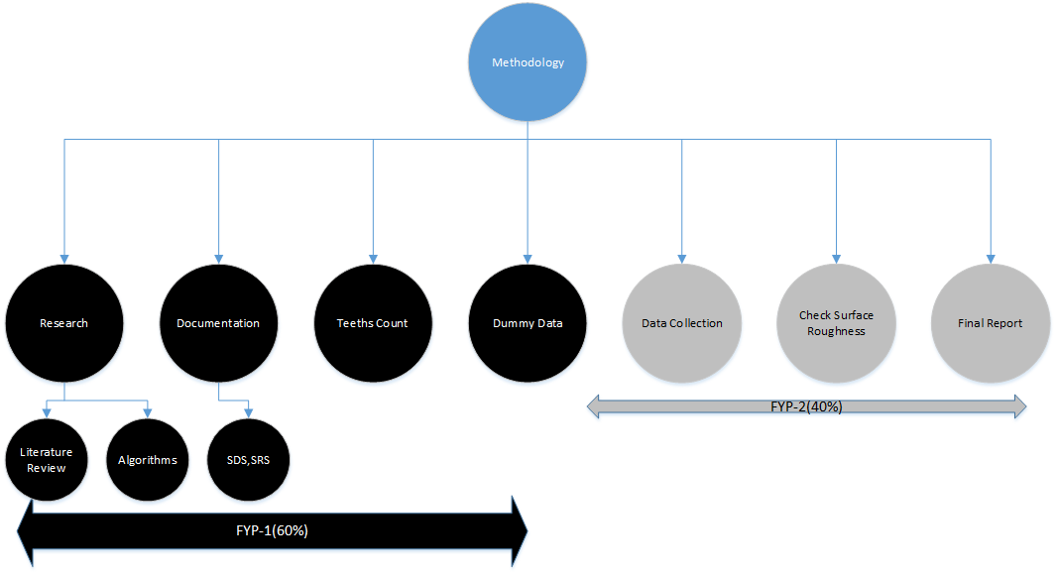
Scope

Slide 9
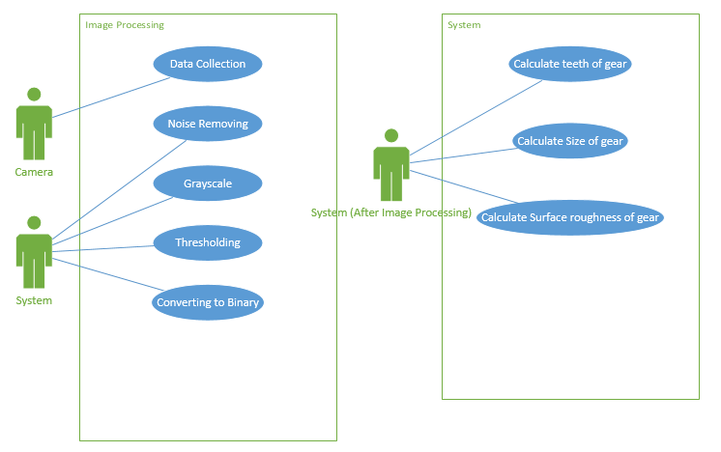
Requirement Analysis Artifacts

Slide 10
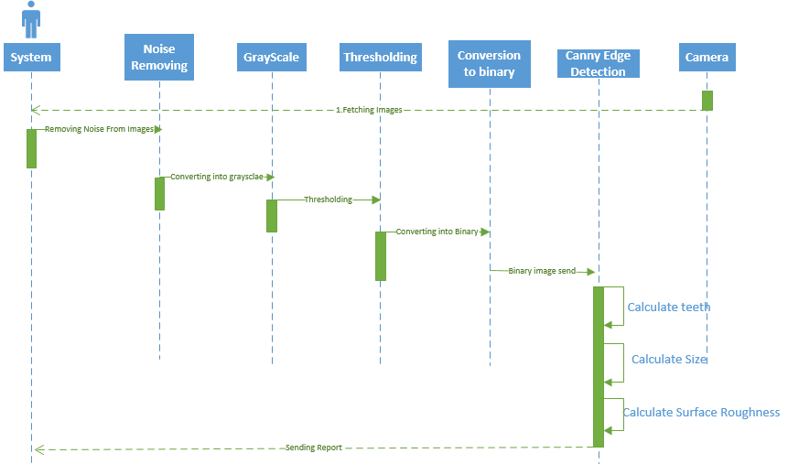
System Sequence Diagram

Slide 11
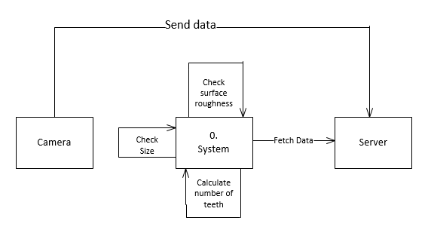
Context Diagram

Slide 12
Use-Case # | Uc-001
Description | Camera will capture the images
Pre-Condition | Camera should be powered on
Use-Case
Camera will capture the images | Image captured into the camera
Post-Condition | Data will be uploaded to the servers.
Use-Case # | Uc-002
Description | Data will be uploaded onto the server
Pre-Condition | Image should be captured and the camera is connected to the server.
Use-Case
Data uploaded on server | Images saved on server
Post-Condition | System will fetch data from the server

Slide 13
Use-Case # | Uc-003
Description | System will fetch image
Pre-Condition | System should be connected to cloud
Use-Case
Images ready to be processed | Images will be opened into the system
Post-Condition | Image will be processed
Use-Case # | Uc-004
Description | Noise removal of the images
Pre-Condition | Image should in process
Use-Case
Noise Removal | It will remove the noise from the image
Post-Condition | Output image with noise removed

Slide 14
Use-Case # | Uc-005
Description | Convert image into greyscale
Pre-Condition | Image should be in process
Use-Case
Conversion to greyscale | The image will be converted into greyscale.
Post-Condition | Output image into greyscale
Use-Case # | Uc-006
Description | Setting threshold
Pre-Condition | Image should be converted into greyscale
Use-Case | Set Threshold value | Threshold value will be set
Post-Condition | Threshold value adjusted

Slide 15
Use-Case # | Uc-007
Description | Conversion to Binary
Pre-Condition | Image should be in grayscale format
Use-Case | Converting image to Binary | Image will be converted into binary form
Post-Condition | Image converted into binary
Use-Case # | Uc-008
Description | Calculating Teeth’s of gear
Pre-Condition | Image should be in binary format
Use-Case
Calculating number of teeth of gear using edge detection algorithms | Report will be generated
Post-Condition | Number of teeth

Slide 16
Use-Case # | Uc-009
Description | Calculating size of gear
Pre-Condition | Image should be in binary format
Use-Case | Calculating size of gear | Report will be generated
Post-Condition | Diameter of the gear in float
Use-Case # | Uc-0010
Description | Calculate Surface roughness
Pre-Condition | Image should in binary form
Use-Case
Calculating surface roughness of gear | Report will be generated
Post-Condition

Slide 17
Test Case ID | Test Case Name | Test Case Summary | Test Case Steps | Expected Result | Actual Result
TestCase_1 | Fetch Images | Fetching images from camera, which is connect to Server. | Connected to Server | Fetch Image properly. | Passed
Test Case ID | Test Case Name | Test Case Summary | Test Case Steps | Expected Result | Actual Result
TestCase_2 | Remove Noise | Remove Noise From picture to clear the image which increase processing | Apply bilateral Filter and median blur filter | Remove all unwanted Pixel | Passed
Test Case ID | Test Case Name | Test Case Summary | Test Case Steps | Expected Result | Actual Result
TestCase_3 | Count teeth | Calculate Teeth of gear using Canny edge detection and contours. | Apply Canny algorithm then using contours detect outer edges and draw contour on them. | Count Exact teeth in gear | Passed
Test Case # 2
Test Case # 3

Slide 18
Thank You

